Slide 1
Honors/IH Precalculus
&
HL Math: Analysis and Approaches

Slide 2
Mr. Buehrer
Graduated from University of Northern Iowa
19 years at Plano East
Previous courses taught
Algebra II, Geometry, AP Statistics,
AP Calculus (AB & BC)
Current Courses
IH/Honors Precalculus (16 years),
IB High Level Math: Analysis & Approaches (3yrs)

Slide 3
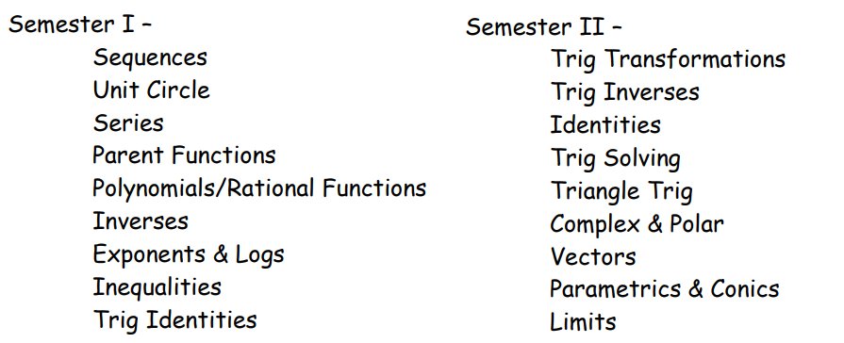
Honors Precalculus Topics

Slide 4
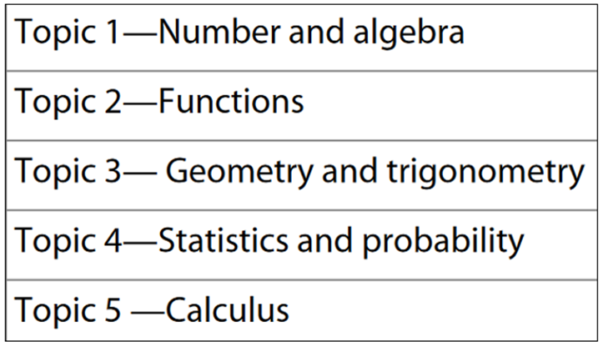
HL Math: Analysis and Approaches Topics

Slide 5
Contact information
Email: ryan.buehrer@pisd.edu
Phone Extension: 39064

